Slide 1

Complex Integration
EE2007 – Engineering Mathematics II

Slide 2
Complex Integration > Learning Objectives
At the end of this lesson, you should be able to:
Explain the line integrals of complex functions.
Explain Cauchy’s Integral Theorem and Cauchy’s Integral Formula.

Slide 3
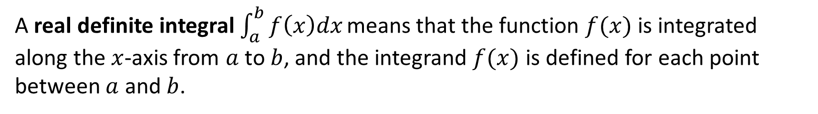
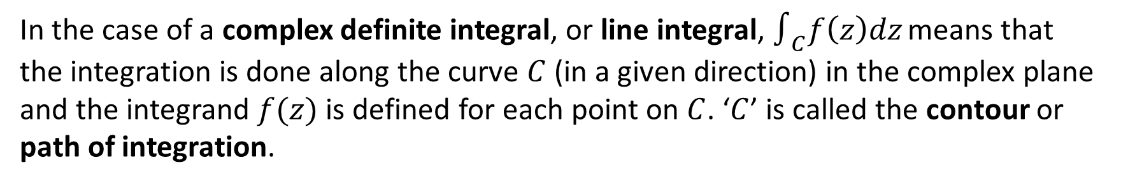
Complex Integration > Introduction
A real definite integral $\int_{a}^{b}{f\left(x\right)dx}$ means that the function $f(x)$ is integrated along the $x$-axis from $a$ to $b$, and the integrand $f(x)$ is defined for each point between $a$ and $b$.
1
In the case of a complex definite integral, or line integral, $∫_{C}f\left(z\right)dz$ means that the integration is done along the curve $C$ (in a given direction) in the complex plane and the integrand $f(z)$ is defined for each point on $C$. ‘$C$’ is called the contour or path of integration.
2
3
If $C$ is a closed contour, the complex line integral is sometimes denoted by $∮_{C}f\left(z\right)dz$.
4
If $C$ is on the real axis, then, $z=x$, and the complex line integral becomes a real definite integral.

Slide 4
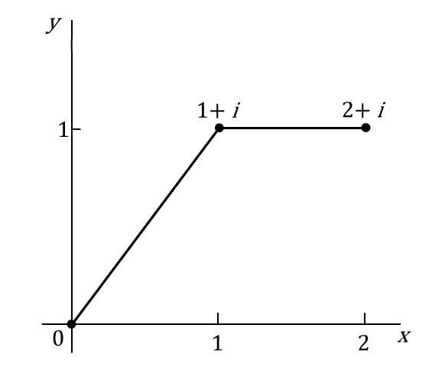

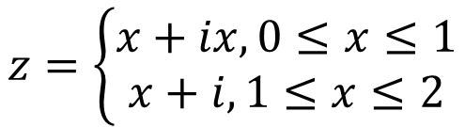
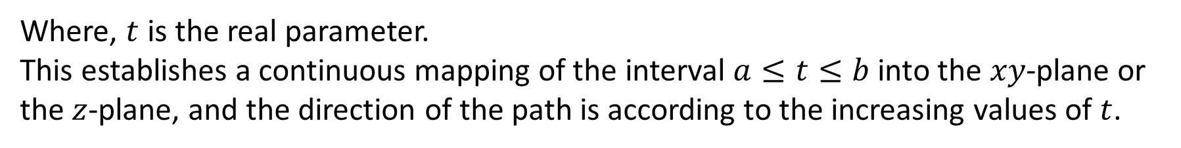
Complex Integration > Parametric Representation of Contour
A contour or path of integration on the complex plane can be represented in the following form.
$$z\left(t\right)=x\left(t\right)+iy(t), a≤t≤b$$
Where, $t$ is the real parameter.
This establishes a continuous mapping of the interval $a≤t≤b$into the $xy$-plane or the $z$-plane, and the direction of the path is according to the increasing values of $t$.
For example,
The path in the figure on the right can be represented by:
$$z=\left\{\begin{aligned}x+ix, 0≤x≤1 \\ x+i, 1≤x≤2\end{aligned}\right.$$

Slide 5
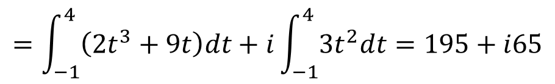
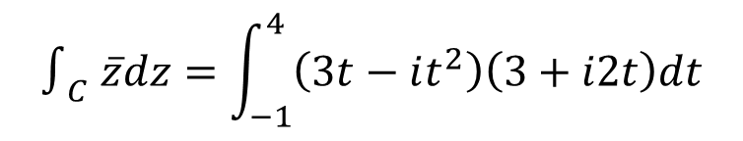


Complex Integration > Parametric Representation of Contour
Let us take a look at the following sample problem to understand the concept of line integral.
Sample Problem 1
Evaluate $∫_{C}\overline{z}dz$ , where $C$ is given by:
$x=3t$, $y=t2$, $‒1≤t≤4$
Solution:
As $z=x +iy$, $z(t)=3t+it2$, and $dz(t)=\left(3+i2t\right)dt$
Therefore,
$$∫_{C} \overline{z}dz=\int_{−1}^{4}{\left(3t−it^{2}\right)\left(3+i2t\right)dt}$$
$$=\int_{−1}^{4}{\left(2t^{3}+9t\right)dt}+i\int_{−1}^{4}{3t^{2}dt}=195+i65$$

Slide 6




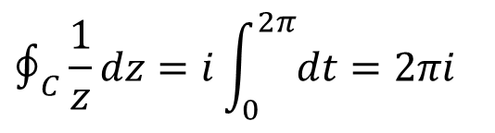
Complex Integration > Parametric Representation of Contour
Let us take a look at another sample problem to understand the concept of line integral.
Sample Problem 2
$$∮_{C}\frac{1}{z}dz$$
Evaluate
, where $C$is the unit circle in the complex plane,
counter-clockwise.
y
Solution:
The path $C$ can be represented by:
$z\left(t\right)=cost+i sint=e^{it}$, $0≤t≤2π$
And, $dz\left(t\right)=ie^{it}dt=izdt$
x
1
$$∮_{C}\frac{1}{z}dz=i\int_{0}^{2π}{dt}=2πi$$
Hence,

Slide 7
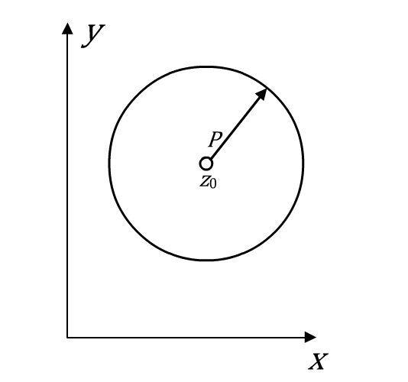



Complex Integration > Parametric Representation of Contour
Here is another sample problem explaining the concept of line integral.
Sample Problem 3
Evaluate $∫_{C}{(z−z_{0})}^{m}dz$, where $C$ is a counter-clockwise circle of radius $ρ$
with centre at $z_{0}$.
Solution:
The path is represented as:
$z\left(θ\right)=z_{0}+ρe^{iθ}$, $0≤θ≤2π$
Then,
${(z−z_{0})}^{m}=ρ^{m}e^{imθ}$ and $dz=iρe^{iθ}dθ$

Slide 8



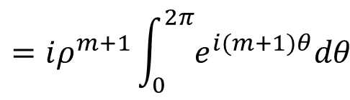
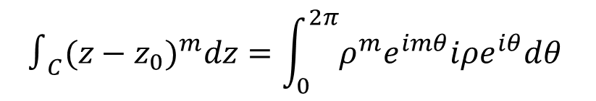
Complex Integration > Parametric Representation of Contour
Here is another sample problem explaining the concept of line integral.
Solution (contd.):
Hence,
$$∫_{C}{(z−z_{0})}^{m}dz=\int_{0}^{2π}{ρ^{m}e^{imθ}iρe^{iθ}dθ }$$
$$=iρ^{m+1}\int_{0}^{2π}{e^{i(m+1)θ}dθ }$$
$$=\left\{\begin{aligned}2πi \\ 0\end{aligned}\right.$$
$$m=−1$$
$m≠−1$, $m$ integer

Slide 9
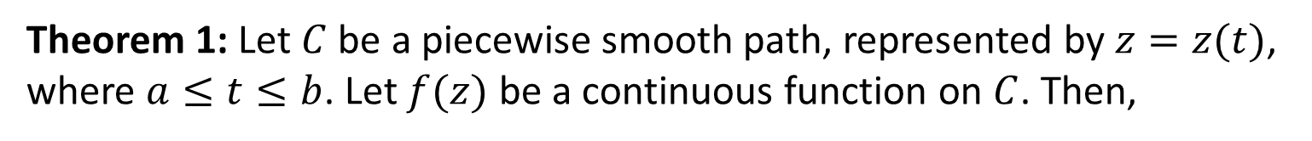
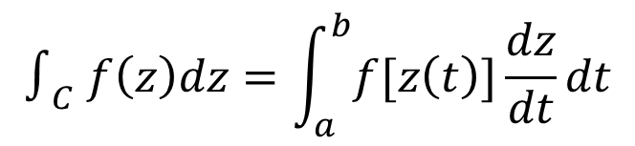
Complex Integration > Integration by the Use of the Path
The following theorem provides a practical method to evaluate a complex line integral.
Theorem 1: Let $C$ be a piecewise smooth path, represented by $z=z(t)$, where $a≤t≤b$. Let $f(z)$ be a continuous function on $C$. Then,
$$∫_{C} f\left(z\right)dz=\int_{a}^{b}{f[z\left(t\right)]}\frac{dz}{dt}dt$$

Slide 10
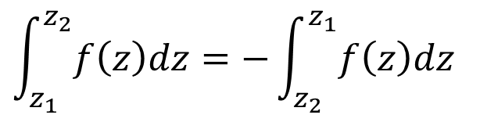

Complex Integration > Basic Properties of Complex Line Integrals
There are three basic properties of complex line integrals.
1
Linearity
$$∫_{C}\left[k_{1}f_{1}\left(z\right)+k_{2}f_{2}\left(z\right)\right]dz=k_{1}∫_{C}f_{1}\left(z\right)dz+k_{2}∫_{C}f_{2}\left(z\right)dz$$
2
Subdivision of Path
$$∫_{C}f\left(z\right)dz=∫_{C_{1}}f\left(z\right)dz+∫_{C_{2}}f\left(z\right)dz$$
$$\int_{z_{1}}^{z_{2}}{f\left(z\right)dz}=−\int_{z_{2}}^{z_{1}}{f\left(z\right)dz}$$
3
Sense of Integration

Slide 11
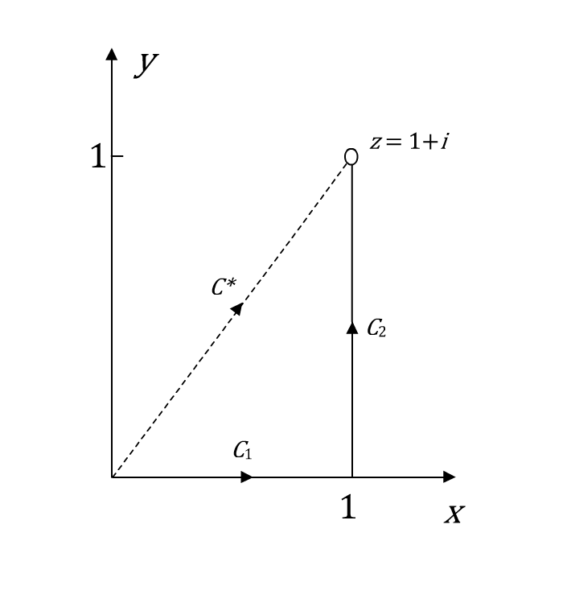



Complex Integration > Basic Properties of Complex Line Integrals
The given sample problem demonstrates the use of the basic properties of line integrals.
Sample Problem 4a
$$\int_{0}^{1+i}{Re z dz}$$
Evaluate
along:
(A) $C^{∗}$
(B) $C1$ and $C$₂

Slide 12

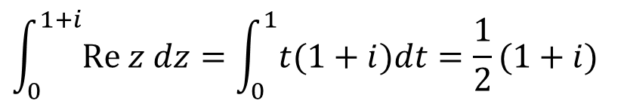


Complex Integration > Basic Properties of Complex Line Integrals
The given sample problem demonstrates the use of the basic properties of line integrals.
Solution:
(A)
Along $C^{∗}$, $z$ is represented by:
$$z(t)=t+it, 0≤t≤1$$
Which gives, $dz=\left(1+i\right)dt$
Hence,
$$\int_{0}^{1+i}{Re z dz}=\int_{0}^{1}{t(1+i)dt}=\frac{1}{2}(1+i)$$

Slide 13

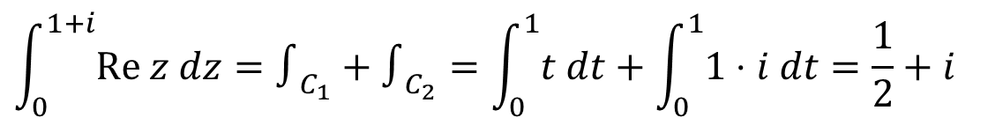
Complex Integration > Basic Properties of Complex Line Integrals
The given sample problem demonstrates the use of the basic properties of line integrals.
Solution (contd.):
(B)
Along $C1$: $z(t)=t, 0≤t≤1$ and $d(z)=dt$
Along $C2$: $z(t)=1+it, 0≤t≤1$ and $d(z)=idt$
Hence,
$$\int_{0}^{1+i}{Re z dz}=∫_{C_{1}}+∫_{C_{2}}=\int_{0}^{1}{t dt}+\int_{0}^{1}{1⋅i dt}=\frac{1}{2}+i$$

Slide 14

Complex Integration > Basic Properties of Complex Line Integrals
The given sample problem demonstrates the use of the basic properties of line integrals.
Sample Problem 4b
$$\int_{0}^{1+i}{z dz}$$
Evaluate
along:
(A) $C^{∗}$
(B) $C1$ and $C$₂

Slide 15

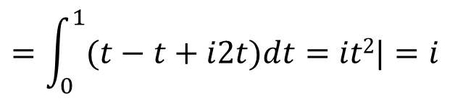
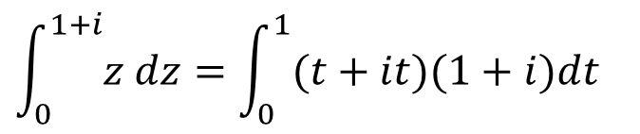


Complex Integration > Basic Properties of Complex Line Integrals
The given sample problem demonstrates the use of the basic properties of line integrals.
Solution:
(A)
Along $C^{∗}$, $z$ is represented by:
$$z(t)=t+it, 0≤t≤1$$
Which gives, $dz=\left(1+i\right)dt$
Hence,
$$\int_{0}^{1+i}{z dz}=\int_{0}^{1}{(t+it)(1+i)dt}$$
$$=\int_{0}^{1}{(t−t+i2t)dt}=it2|=i$$
$$1$$
$$0$$

Slide 16

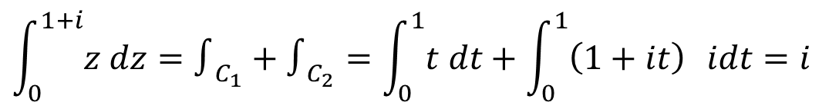
Complex Integration > Basic Properties of Complex Line Integrals
The given sample problem demonstrates the use of the basic properties of line integrals.
Solution (contd.):
(B)
Along $C1$: $z(t)=t, 0≤t≤1$ and $d(z)=dt$
Along $C2$: $z(t)=1+it, 0≤t≤1$ and $d(z)=idt$
Hence,
$$\int_{0}^{1+i}{z dz}=∫_{C_{1}}+∫_{C_{2}}=\int_{0}^{1}{t dt}+\int_{0}^{1}{\left(1+it\right) }idt=i$$
$$⋅$$

Slide 17




Complex Integration > Basic Properties of Complex Line Integrals
Here is another sample problem demonstrating the use of the basic properties of line integrals.
Sample Problem 5
Evaluate $∫_{C}\overline{z}dz$ from $z=0$to $z=4+2i$ along the curve given by the
line $z=0$ to $z=2i$ and then the line from $z=2i$ to $z=4+2i$.
Solution:
Along $z=0$ to $z=2i$:
$z(t)=0+it$, $0≤t≤2$ and $d(z)=idt$
Along $z=2i$ to $z=4+2i$:
$z(t)=t+2i$, $0≤t≤4$ and $d(z)=dt$

Slide 18






Complex Integration > Basic Properties of Complex Line Integrals
Here is another sample problem demonstrating the use of the basic properties of line integrals.
Solution (contd.):
$∫_{C}\overline{z}dz=\int_{0}^{2}{tdt}+\int_{0}^{4}{\left(t−2i\right)dt}$
$=2+\int_{0}^{4}{tdt}−2i\int_{0}^{4}{dt}$
$$4$$
$$=2+\left[\frac{t^{2}}{2}\right] −8i$$
$$0$$
$$=2+8−8i=10−8i$$

Slide 19
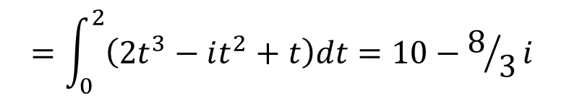


Complex Integration > Basic Properties of Complex Line Integrals
Here is another sample problem demonstrating the use of the basic properties of line integrals.
Sample Problem 6
Evaluate $∫_{C}\overline{z}dz$ from $z=0$to $z=4+2i$, where $C$ is a parabola given by $x=y2$.
Solution:
$z(t)=t2+it$, $0≤t≤2$ and $d(z)=\left(2t+i\right)dt$
$∫_{C}\overline{z}dz=\int_{0}^{2}{\left(t^{2}−it\right)\left(2t+i\right)dt}$
$$=\int_{0}^{2}{\left({2t}^{3}−it^{2}+t\right)dt}=10−8/3i$$

Slide 20


Complex Integration > Simple Closed Path and Simply Connected Domain
?
A line integral of $f(z)$ in the complex plane may not always depend on the choice of the path itself. Sometimes, the integrals evaluated turn out to be zero or $2πi$.
To answer these questions, you need to know about the:
Concept of Simple Closed Path and Simply Connected Domain
Cauchy’s Integral Theorem
Under what condition will the integral be independent of the path?
1
Under what condition will the integral be zero?
2
Is there something special about the value $2πi$?
3

Slide 21


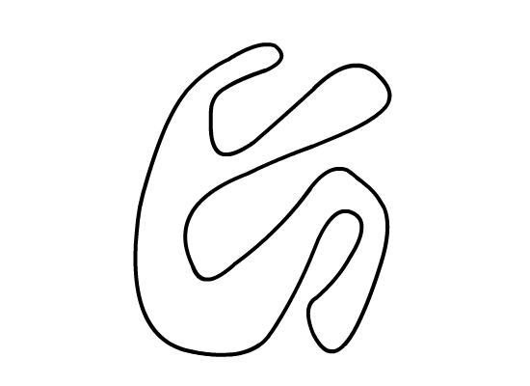

Complex Integration > Simple Closed Path and Simply Connected Domain
A simple closed path is a path that does not intersect or touch itself.
Simple
Not Simple
Simple
Not Simple

Slide 22




Complex Integration > Simple Closed Path and Simply Connected Domain
A simply connected domain $D$ in the complex plane is a domain such that every simple closed path in $D$ encloses only points of $D$.
Simply Connected
Triply Connected
Simply Connected
Doubly Connected

Slide 23
Complex Integration > Simple Closed Path and Simply Connected Domain
A simply connected domain $D$ in the complex plane is a domain such that every simple closed path in $D$ encloses only points of $D$.
A domain that is not simply connected is called multiply connected.
Intuitively, a simply connected domain is the one which does not have any ‘holes’ in it, while a multiply connected domain is the one which does.
Simply Connected
Triply Connected
Simply Connected
Doubly Connected

Slide 24
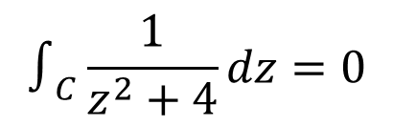



Complex Integration > Cauchy’s Integral Theorem
Cauchy’s Integral Theorem is an important theorem describing the line integrals of analytic functions in a complex plane.
Theorem 2: If $f(z)$ is analytic in a simply connected domain $D$, then for every simple closed path $C$ in $D$,
$∫_{C}f(z)dz=0$
For example, $∫_{C}e^{z}dz=0$, $∫_{C}\cos{z}dz=0$, and $∫_{C}z^{n}dz=0$; $n = 0, 1, …$
for any closed path as these functions are entire, that is, analytic for all $z$.
$$∫_{C}\frac{1}{z^{2}+4}dz=0$$
And,
where, $C$ is a unit circle.
Although the integrand is not analytic at $z=±2i$, these points are not enclosed by $C$.

Slide 25
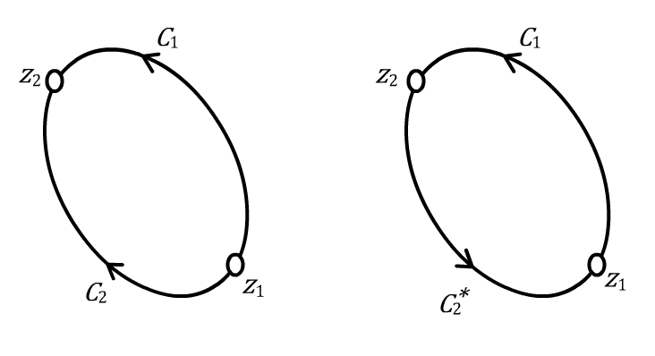
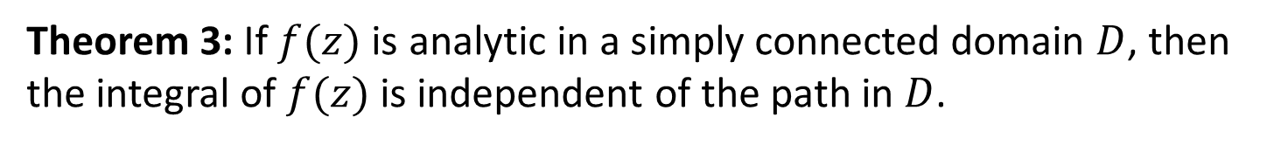


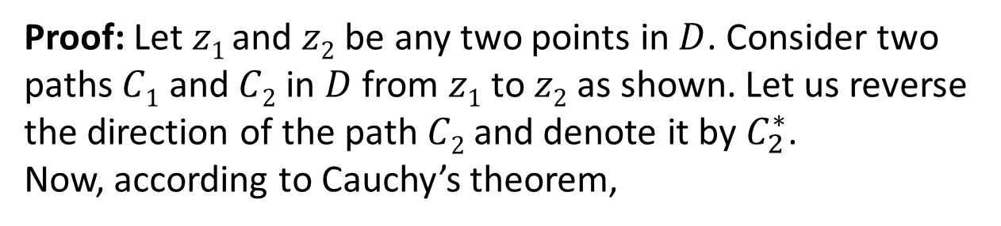
Complex Integration > Independence of Path
Let us try to understand the condition under which the line integral of a complex function would be independent of the path of integration.
Theorem 3: If $f(z)$ is analytic in a simply connected domain $D$, then the integral of $f(z)$ is independent of the path in $D$.
Proof: Let $z1$ and $z2$be any two points in $D$. Consider two paths $C1$ and $C2$ in $D$ from $z1$ to $z2$as shown. Let us reverse the direction of the path $C2$and denote it by $C_{2}^{∗}$.
Now, according to Cauchy’s theorem,
$$∫_{C_{1}}fdz+∫_{C_{2}^{∗}}fdz=0$$
Thus,
$$∫_{C_{1}}fdz=−∫_{C_{2}^{∗}}fdz=∫_{C_{2}}fdz$$

Slide 26
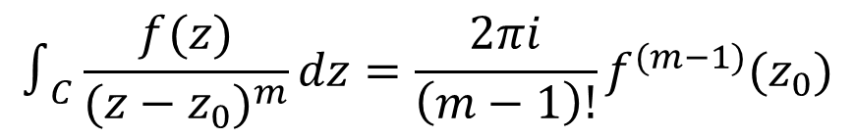
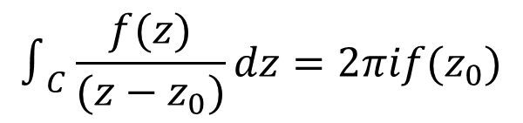
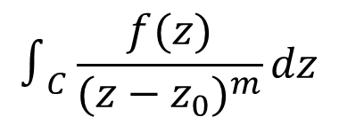



Complex Integration > Cauchy’s Integral Formula
The most important consequence of Cauchy’s Integral Theorem is Cauchy’s integral formula. This formula is useful to evaluate integrals of the following form.
$$∫_{C}\frac{f(z)}{{(z−z_{0})}^{m}}dz$$
where, $m=1, 2, 3,…$
Theorem 4: Let $f(z)$ be analytic in a simply connected domain $D$. Then, for any point $z₀$ in $D$and any simple closed path $C$in $D$ that encloses $z₀$.
$$∫_{C}\frac{f(z)}{(z−z_{0})}dz=2πif(z_{0})$$
In general,
$$∫_{C}\frac{f(z)}{{(z−z_{0})}^{m}}dz=\frac{2πi}{\left(m−1\right)!}f^{(m−1)}{(z}_{0})$$
where, $m=1, 2, 3,…$
Note: The integration is being taken counter-clockwise. Refer to the textbook for the proof of the theorem.

Slide 27



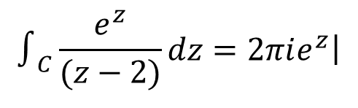
Complex Integration > Cauchy’s Integral Formula
The following sample problem shows how Cauchy’s integral formula is used to solve complex line integrals.
Sample Problem 7
$$∫_{C}\frac{e^{z}}{(z−2)}dz$$
Evaluate
Solution:
$$∫_{C}\frac{e^{z}}{(z−2)}dz=2πi\left.e^{z}\right|$$
$$z=2$$
$$=2πie^{2}$$

Slide 28
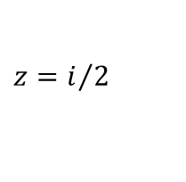

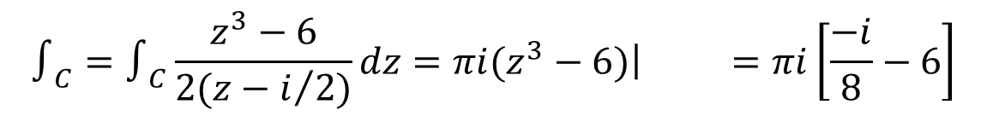



Complex Integration > Cauchy’s Integral Formula
The following sample problem shows how Cauchy’s integral formula is used to solve complex line integrals.
Sample Problem 8
$$∫_{C}\frac{z^{3}−6}{2z−i}dz$$
Evaluate
, where $C$ is a unit circle in counter- clockwise
direction.
Solution:
$$z=\frac{i}{2}$$
Since $C$ encloses
$$∫_{C}=∫_{C}\frac{z^{3}−6}{2(z−i/2)}dz=πi\left.(z^{3}−6)\right| =πi\left[\frac{−i}{8}−6\right]$$
$$z=i/2$$

Slide 29



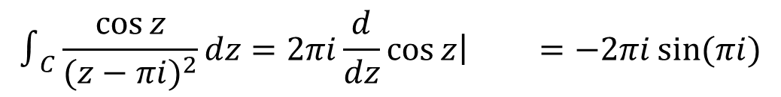
Complex Integration > Cauchy’s Integral Formula
The following sample problem shows how Cauchy’s integral formula is used to solve complex line integrals.
Sample Problem 9
Evaluate
$$∫_{C}\frac{\cos{z}}{{(z−πi)}^{2}}dz$$
, where $C$ is any contour enclosing $z=πi$
in counter-clockwise direction.
Solution:
$$∫_{C}\frac{\cos{z}}{{(z−πi)}^{2}}dz=2πi\frac{d}{dz}\left.\cos{z}\right| =−2πi\sin{(πi)}$$
$$z=πi$$

Slide 30




Complex Integration > Cauchy’s Integral Formula
The following sample problem shows how Cauchy’s integral formula is used to solve complex line integrals.
Sample Problem 10
$$∫_{C}\frac{z^{4}−3z^{2}+6}{{(z+i)}^{3}}dz$$
Evaluate
, where $C$ is any contour enclosing $z= ‒i$
in counter-clockwise direction.
Solution:
$$∫_{C}=\frac{2πi}{2!}\frac{d^{2}}{dz^{2}}\left.(z^{4}−3z^{2}+6)\right| =πi\left.(12z^{2}−6) \right| =−18πi$$
$$z=−i$$
$$z=−i$$

Slide 31
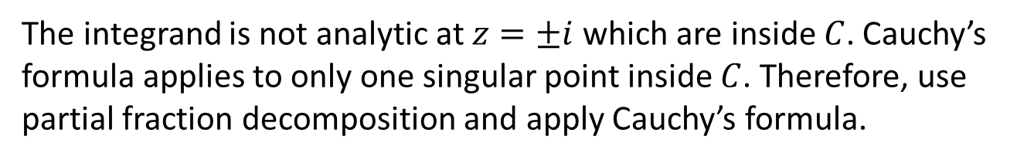
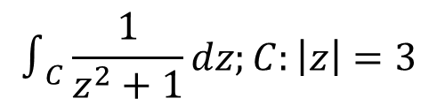
Complex Integration > Cauchy’s Integral Formula
The following sample problem shows how Cauchy’s integral formula is used to solve complex line integrals.
Sample Problem 11
$$∫_{C}\frac{1}{z^{2}+1}dz;C:\left|z\right|=3$$
Evaluate
, in counter-clockwise direction.
Solution:
The integrand is not analytic at $z=±i$ which are inside $C$. Cauchy’s formula applies to only one singular point inside $C$. Therefore, use partial fraction decomposition and apply Cauchy’s formula.

Slide 32
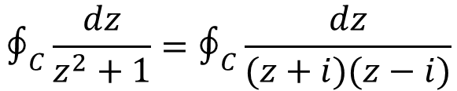
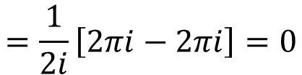
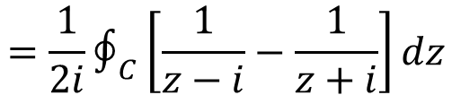
Complex Integration > Cauchy’s Integral Formula
The following sample problem shows how Cauchy’s integral formula is used to solve complex line integrals.
Solution (contd.):
$$∮_{C}\frac{dz}{z^{2}+1}=∮_{C}\frac{dz}{(z+i)(z−i)}$$
$$=\frac{1}{2i}∮_{C}\left[\frac{1}{z−i}−\frac{1}{z+i}\right]dz$$
$$=\frac{1}{2i}\left[2πi−2πi\right]=0$$

Slide 33
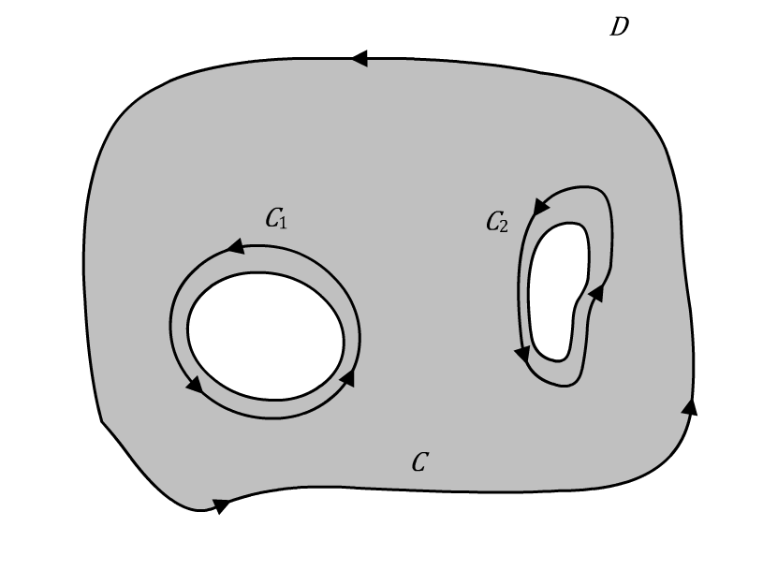
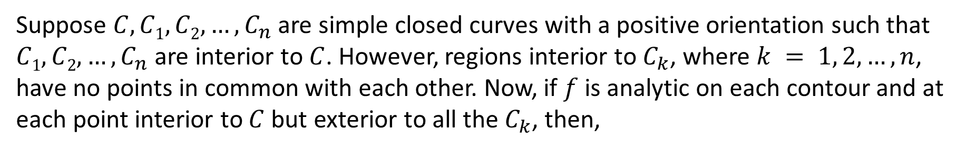

Complex Integration > Cauchy’s Theorem for Multiply Connected Domains
Suppose $C, C1, C2,…, C_{n}$ are simple closed curves with a positive orientation such that $C1, C2,…,C_{n}$ are interior to $C$. However, regions interior to $C_{k}$, where $k = 1, 2,…, n$, have no points in common with each other. Now, if $f$is analytic on each contour and at each point interior to $C$ but exterior to all the $C_{k}$, then,
$$∮_{C}f\left(z\right)dz=\sum_{k=1}^{n}{∮_{C_{k}} f(z)}dz$$

Slide 34




Complex Integration > Cauchy’s Theorem for Multiply Connected Domains
Here is a sample problem showcasing how Cauchy’s theorem for multiply connected domains can be used to integrate complex functions.
Sample Problem 12
$$∮_{C}\frac{1}{z^{2}+1}dz$$
Evaluate
; where $C$ is the circle $\left|z\right|=3$ in counter-clockwise
direction.
Solution:
$$\frac{1}{z^{2}+1}$$
The integrand
is not analytic at $z=±i$. Both of these points
lie within the contour $C$.

Slide 35


Complex Integration > Cauchy’s Theorem for Multiply Connected Domains
Here is a sample problem showcasing how Cauchy’s theorem for multiply connected domains can be used to integrate complex functions.
Solution (contd.):
Introduce $C1$ and $C2$ as shown in the figure to exclude these points and then, use Cauchy’s theorem on this multiply connected domain.

Slide 36






Complex Integration > Cauchy’s Theorem for Multiply Connected Domains
Here is a sample problem showcasing how Cauchy’s theorem for multiply connected domains can be used to integrate complex functions.
Solution (contd.):
$$∮_{C}\frac{dz}{z^{2}+1}=∮_{C}\frac{dz}{(z+i)(z−i)}$$
$$=∮_{C_{1}}\frac{1/{(z+i)}}{(z−i)}dz+∮_{C_{2}}\frac{1/{(z−i)}}{(z+i)}dz$$
$$=2πi\left.\left[\frac{1}{z+i}\right]\right| +2πi\left.\left[\frac{1}{z−i}\right]\right|$$
$$z=i$$
$$z=−i$$
$$=2πi\frac{1}{2i}+2πi\frac{1}{−2i}=0$$

Slide 37









Complex Integration > Evaluation of Real Integrals
Let us see how real integrals are evaluated using complex functions.
Where, $F\left(\cos{θ},\sin{θ}\right)dθ$ is a real function of $\cos{θ}$ and $\sin{θ}$ and is finite on the interval of integration.
$$\int_{0}^{2π}{F\left(\cos{θ}, \sin{θ}\right)dθ}$$
Basic Idea
Let $z=e^{iθ}$. This gives,
$$cosθ=\frac{z+\overline{z}}{2}$$
$$,sinθ=\frac{z−\overline{z}}{2i}$$
$$⇒dθ=\frac{1}{iz}dz$$
, and $dz=ie^{iθ}dθ$
This allows to convert $F\left(\cos{θ},\sin{θ}\right)dθ$ into $f(z)$, and the integration interval of $0≤θ ≤2π$ is changed to a unit circle.
$$\int_{0}^{2π}{F\left(\cos{θ}, \sin{θ}\right)dθ}=∮_{C} f(z)\frac{1}{iz}dz$$
Thus,
, $C$: unit circle, counter-clockwise direction.

Slide 38



Complex Integration > Evaluation of Real Integrals
The sample problem given below helps us understand the concept of evaluating real integrals using complex functions.
Sample Problem 13
$$\int_{0}^{2π}{\frac{dθ}{\sqrt{2}−\cos{θ}}}$$
Evaluate
Solution:
Let $z=e^{iθ}$. Substituting in the given equation gives,
$$cosθ=\frac{1}{2}\left[z+\frac{1}{z}\right]$$
$$dθ=\frac{dz}{iz}$$
and

Slide 39

Complex Integration > Evaluation of Real Integrals
The sample problem given below helps us understand the concept of evaluating real integrals using complex functions.
Solution (contd.):
The real integral becomes:
$$∮_{C} \frac{{dz}/{iz}}{\sqrt{2}−\frac{1}{2}\left[z+\frac{1}{z}\right]}=\frac{−2}{i}∮_{C} \frac{dz}{\left(z−\left(\sqrt{2}+1\right)\right)\left(z−\left(\sqrt{2}−1\right)\right)}$$
Where, $C$ is a unit circle in counter-clockwise direction.

Slide 40





Complex Integration > Evaluation of Real Integrals
The sample problem given below helps us understand the concept of evaluating real integrals using complex functions.
Solution (contd.):
The integrand has simple pole at $z=\sqrt{2}−1$ inside $C$ and $z=\sqrt{2}+1$ outside $C$. Hence, using Cauchy’s integral formula, the integral is:
$$\frac{−2}{i}∮_{C} \frac{dz}{\left(z−\left(\sqrt{2}+1\right)\right)\left(z−\left(\sqrt{2}−1\right)\right)}$$
$$=\frac{−2}{i}∮_{C}\frac{\frac{1}{\left(z−\left(\sqrt{2}+1\right)\right)}}{\left(z−\left(\sqrt{2}−1\right)\right)}dz$$
$$=\frac{−2}{i}\left(2πi\right)\left.\frac{1}{\left(z−\left(\sqrt{2}+1\right)\right)}\right| =2π$$
$$z=\sqrt{2}−1$$

Slide 41






Complex Integration > Improper Integrals of Rational Fractions
Complex integration can be used to evaluate improper integrals of rational functions.
$$\int_{−∞}^{∞}{f\left(x\right)}dx=∮_{UHP} f\left(z\right)dz=\sum_{k=1}^{n}{∮_{C_{k} in UHP}} f\left(z\right)dz$$
, if
1
$$f\left(x\right)=\frac{p(x)}{q(x)}$$
is a real function with no common factors between
2
$p(x)$ and $q(x)$, and $q(x)≠0$for all real $x$.
Degree of $q\left(x\right)≥$Degree of $p(x)+2$
$$f\left(x\right)=\frac{1}{1+x^{4}}$$
$$f\left(x\right)=\frac{x^{3}}{1+x^{4}}$$
For example,
satisfies the above conditions but
does not.

Slide 42




Complex Integration > Improper Integrals of Rational Fractions
Let’s see how improper integrals of rational fractions are evaluated.
Sample Problem 14
Show that
$$\int_{0}^{∞}{\frac{dx}{1+x^{4}}=\frac{π}{2\sqrt{2}}}$$
Solution:
First, check that $f(x)$ satisfies the assumptions. Now, consider
$$f\left(z\right)=\frac{1}{1+z^{4}}$$
which has four simple poles at $z=e^{{πi}/4}$, $e^{{3πi}/4}$,
$e^{{−3πi}/4}$, and $e^{{−πi}/4}$.

Slide 43


Complex Integration > Improper Integrals of Rational Fractions
Let’s see how improper integrals of rational fractions are evaluated.
Solution (contd.):
Only the first two poles, that is, $e^{{πi}/4} \text{and} e^{{3πi}/4}$, lie inside the UHP. The corresponding complex integral is:
$$∮_{UHP}\frac{1}{1+z^{4}}dz$$
$$=∮_{UHP}\frac{1}{(z−e^{{πi}/4})(z−e^{3{πi}/4})(z−e^{{−3πi}/4})(z−e^{{−πi}/4})}dz$$

Slide 44



Complex Integration > Improper Integrals of Rational Fractions
Let’s see how improper integrals of rational fractions are evaluated.
Solution (contd.):
$$∮_{UHP}\frac{1}{1+z^{4}}dz$$
$$=∮_{C_{1}} \frac{\frac{1}{(z−e^{3{πi}/4})(z−e^{{−3πi}/4})(z−e^{{−πi}/4})}}{(z−e^{{πi}/4})}dz$$
$$+ ∮_{C_{2}} \frac{\frac{1}{(z−e^{{πi}/4})(z−e^{{−3πi}/4})(z−e^{{−πi}/4})}}{(z−e^{3{πi}/4})}dz$$

Slide 45




Complex Integration > Improper Integrals of Rational Fractions
Let’s see how improper integrals of rational fractions are evaluated.
Solution (contd.):
$$∮_{UHP}\frac{1}{1+z^{4}}dz=2πi\left[−\frac{1}{4}e^{{πi}/4}+\frac{1}{4}e^{{−πi}/4}\right]$$
Now, since
$$\frac{1}{1+x^{4}}$$
is even,
$$\int_{0}^{∞}{\frac{dx}{1+x^{4}}}=\frac{1}{2}\int_{−∞}^{∞}{\frac{dx}{1+x^{4}}}$$
$$=\frac{−πi}{4}\left[e^{{iπ}/4}−e^{{−iπ}/4}\right]=\frac{π}{2}\sin{\frac{π}{4}}=\frac{π}{2\sqrt{2}}$$

Slide 46
Summary

Slide 47

Complex Integration > Summary
Key points discussed in this lesson:
In the case of a complex definite integral, or line integral, $∫_{C}f\left(z\right)dz$ means that the integration is done along the curve $C$ (in a given direction) in the complex plane and the integrand $f(z)$ is defined for each point on $C$. ‘$C$’ is called the contour or path of integration.
A line integral of $f(z)$ in the complex plane may not always depend on the choice of the path itself. Sometimes, the integrals evaluated turn out to be zero or $2πi$.
Cauchy’s Integral Theorem is an important theorem describing the line integrals of analytic functions in a complex plane.

Slide 48




Complex Integration > Summary
Key points discussed in this lesson:
The most important consequence of Cauchy’s Integral Theorem is Cauchy’s integral formula. This formula is useful to evaluate integrals of the following form.
$$∫_{C}\frac{f(z)}{{(z−z_{0})}^{m}}dz$$
, $m=1, 2, 3,…$
$$\int_{−∞}^{∞}{f\left(x\right)}dx=∮_{UHP}f\left(z\right)dz=\sum_{k=1}^{n}{∮_{C_{k} in UHP}}f\left(z\right)dz$$
The formula holds true if:
$f(x)=p(x)/q(x)$is a real function with no common factors between $p(x)$ and $q(x)$, and $q(x)≠0$ for all real $x$.
Degree of $q(x)≥$ Degree of $p(x)+2$

